Slide 1

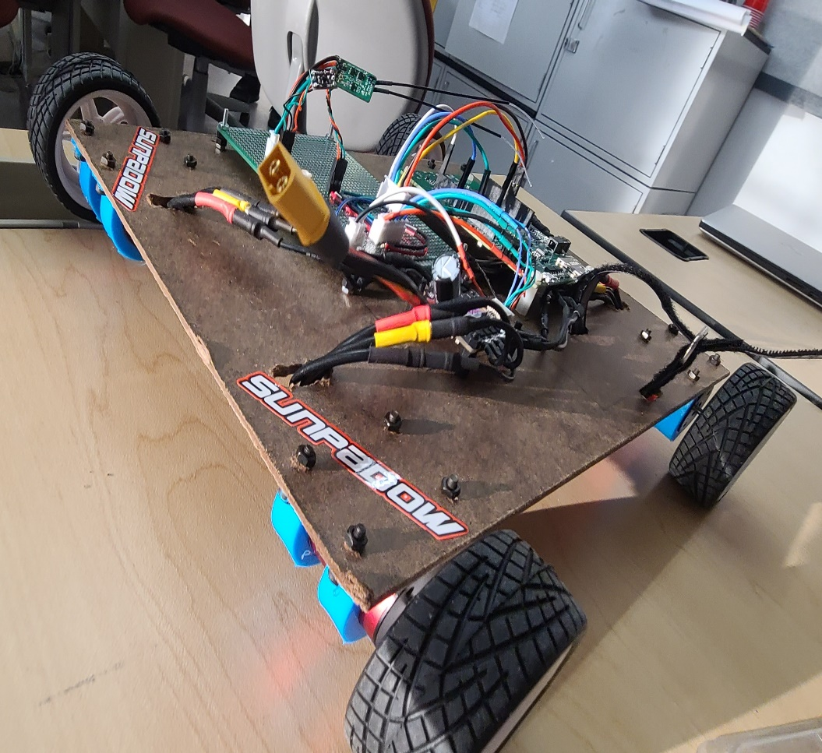
RC CAR
The Mighty Robots
Sam H, James M, and Cameron Y

Slide 2
Overview
We chose to make a remote-controlled car using drone equipment and our knowledge of embedded programming so that the RC car can be controlled by four motors that can go either forwards, backwards, left or right.

Slide 3
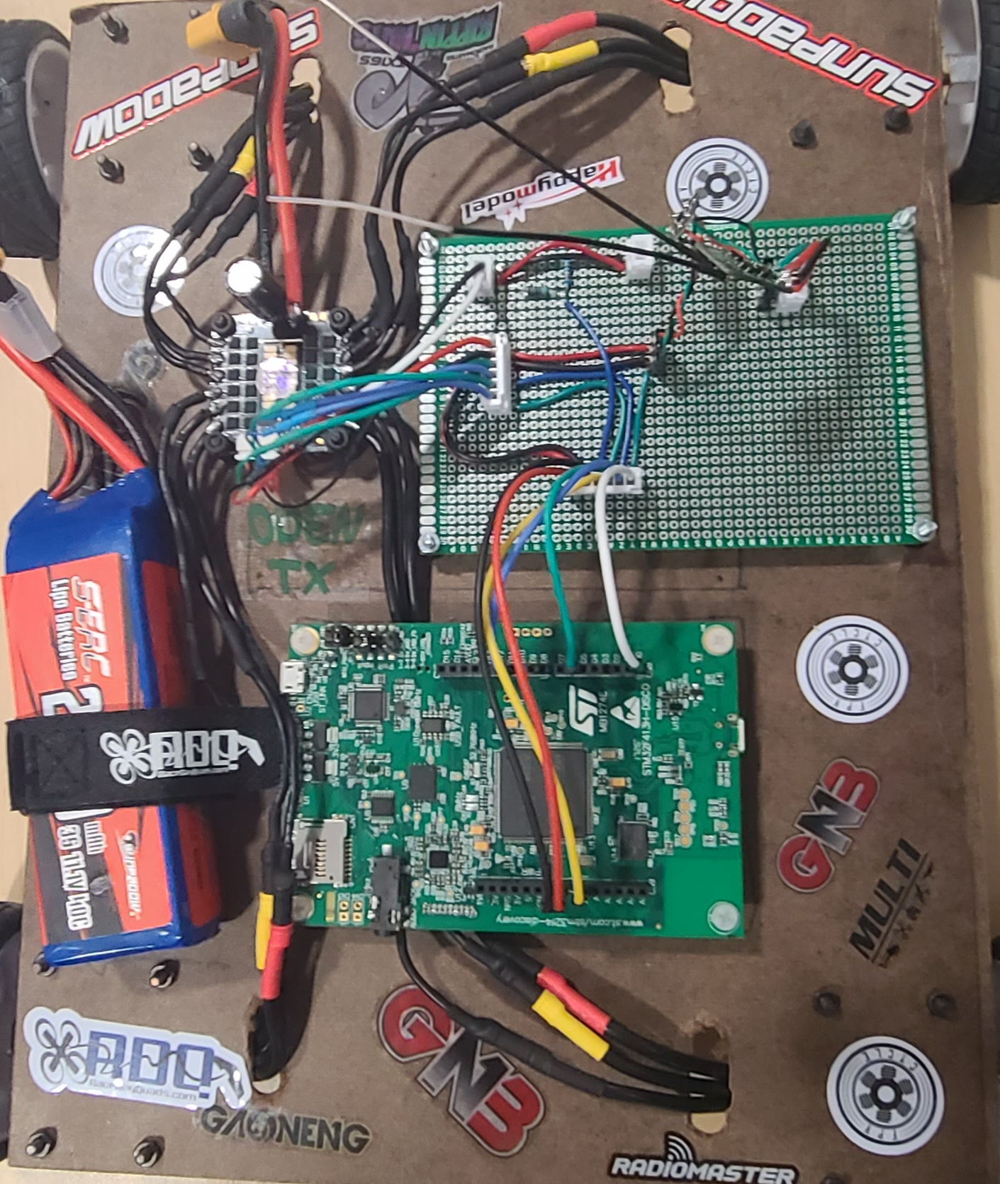
Project Hardware & Software
Project Hardware
STM32F413H-Discovery Board
ESC (controls the individual motors)
Receiver paired with an Inverter
TX16S Radiomaster Controller
4 Motors
Battery
Project Software
CubeIDE
STM32F4_SBUS-main

Slide 4
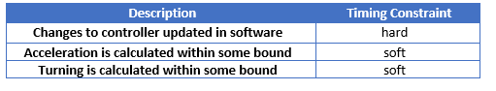
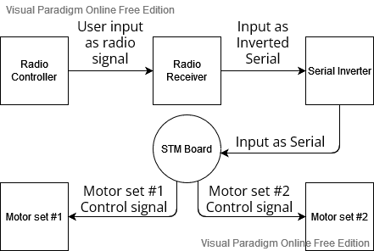
System Context & Timing Constraints

Slide 5
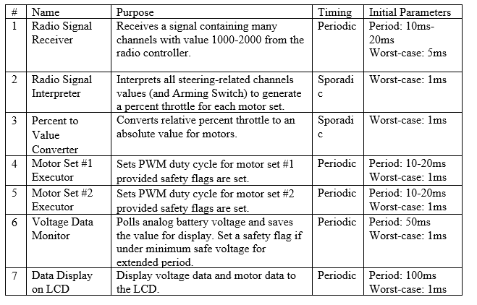
Task Breakdown

Slide 6
IOC: Timers, Suspension, Mutex
PWM TIMERS
OS Timers
Mutex
?
!
TIM3 CH2
TIM3 CH3
RadioReady
LCDReady
RxInput

Slide 7
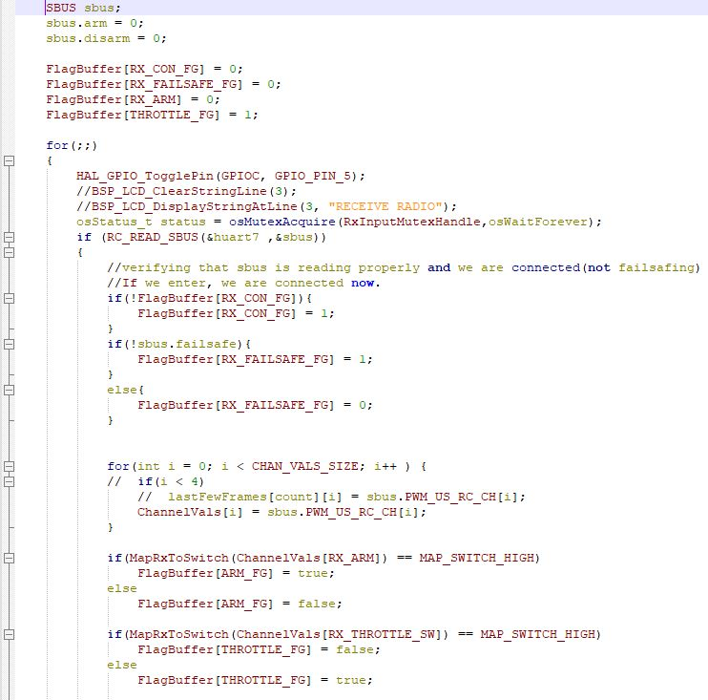
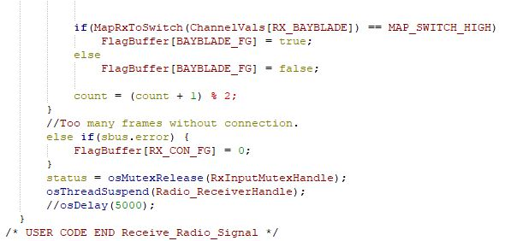
Critical Section Review

Slide 8
Current Project Status
The Project is mostly done
A few throttle issues

Slide 9
Demo
Establish remote radio connection
Arming switch
Single-stick tank control
Throttle scalar (10%)
Operational data collection
Battery voltage (fail-safe)
Collect and display on LCD (disabled)
BB Mode

Slide 10
What we learned
Task MGMT
DMA
C language
UART
SBUS
PWM
ADC
Safety Features
PWM
BL-Helli

Slide 11
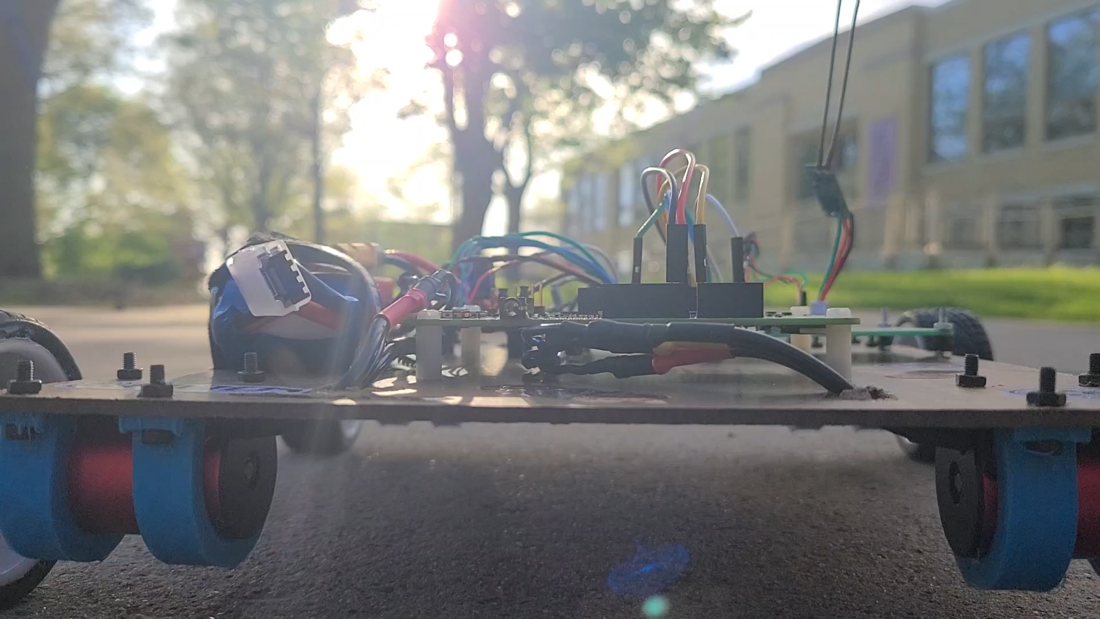
Have a good summer

